Slide 1
Rad-Hard Designs by Automated Latching-Delay Assignment and Time-Borrowable D-Flip-Flop
Dave Y.-W. Lin, John Z.-L. Tang,
Charles H.-P. Wen
Dept. of ECE , National Chiao Tung University
Hsinchu, Taiwan

Slide 2
Outline
1. Introduction
Previous work
Objective
2. Method
Automated Latching-Delay Assignment (ALDA)
Time Borrowing D-Flip Flop (TBD-FF)
3. Experimental Results
Timing performance
Validate latching-delay precision of TBD-FF’s layout
4. Conclusion

Slide 3
1.
Introduction
Previous work
Objective

Slide 4
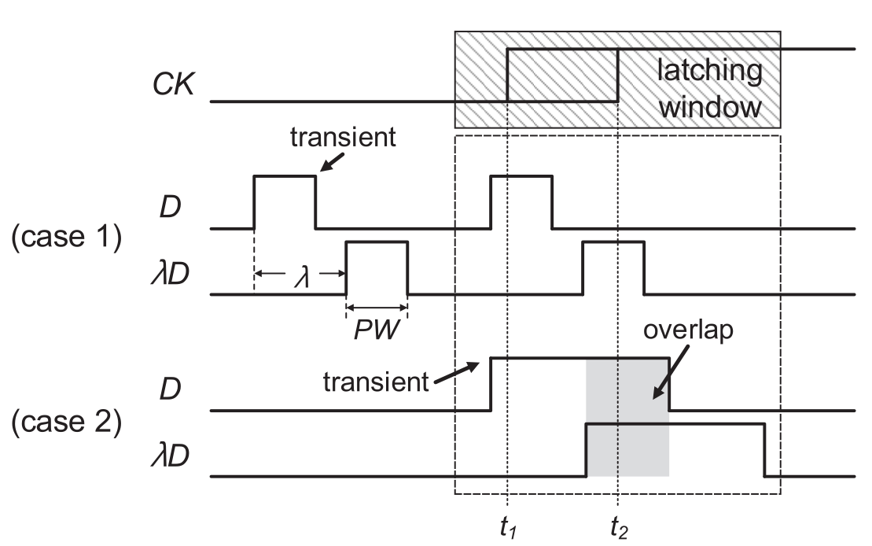
Previous work – Delay Latching(1/7)

Slide 5
Previous work – BISER (2/7)

Slide 6
Previous work – TPM-FF (3/7)

Slide 7
Previous work (4/7)

Slide 8
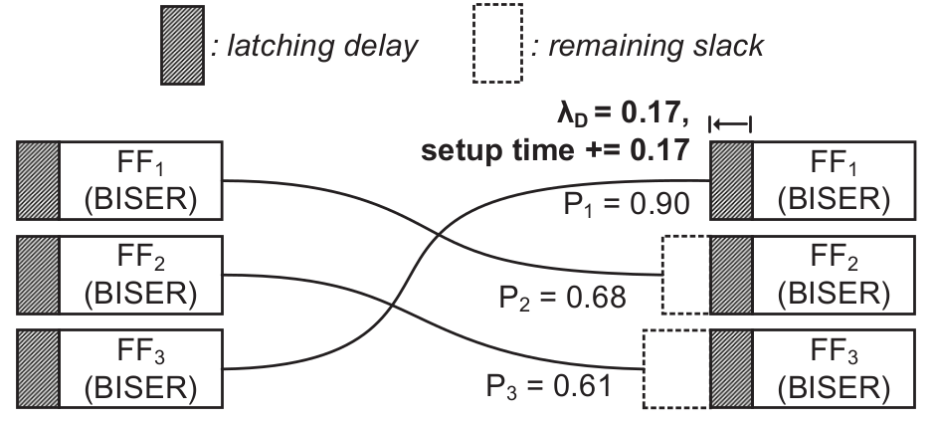
Previous work (5/7)

Slide 9
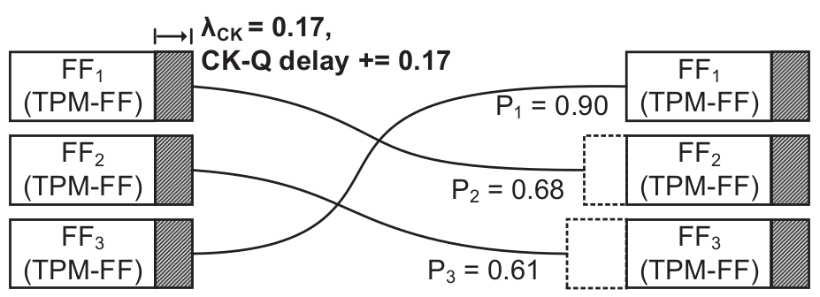
Previous work (6/7)

Slide 10
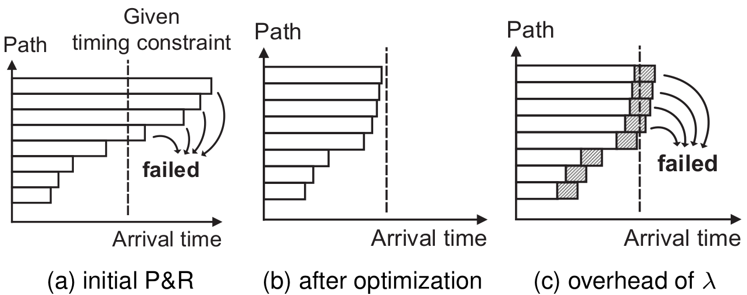
Previous work (7/7)

Slide 11
1.
Introduction
Previous work
Objective

Slide 12
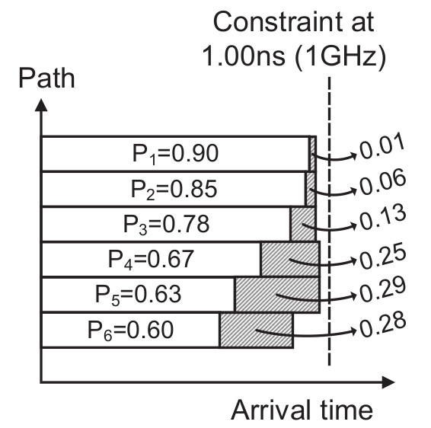
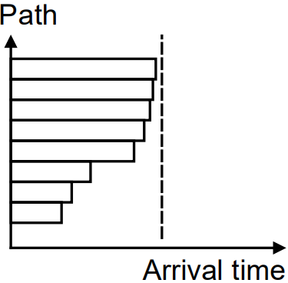
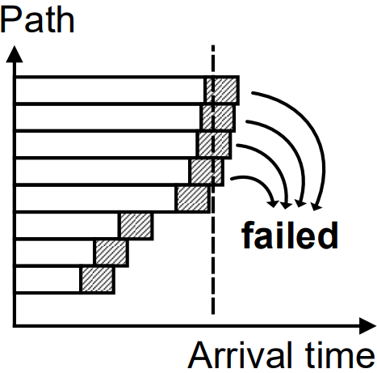
Objective (1/2)

Slide 13
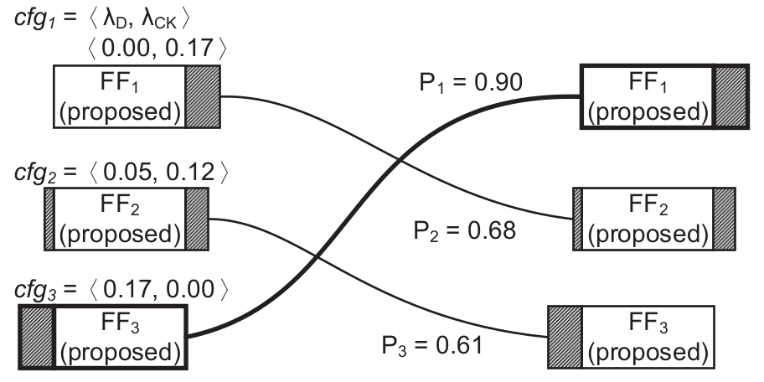
Objective (2/2)

Slide 14
2.
Method
Automated Latching-Delay Assignment (ALDA)
Time Borrowing D-Flip Flop (TBD-FF)

Slide 15
ALDA (1/8)

Slide 16
ALDA (2/8)
SL_{i}‘ = slack remaining on path I C_{P} = arrival time of critical path
r_{i} = regularization term of path i
x_{i} = sliding displacement of path i

Slide 17
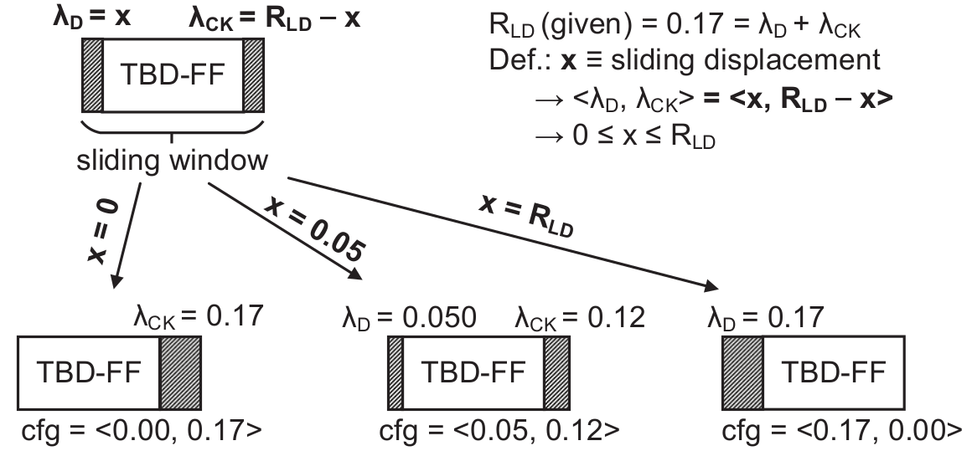
ALDA (3/8)
R_{LD} = required latching delay (ex: 0.17ns)

Slide 18
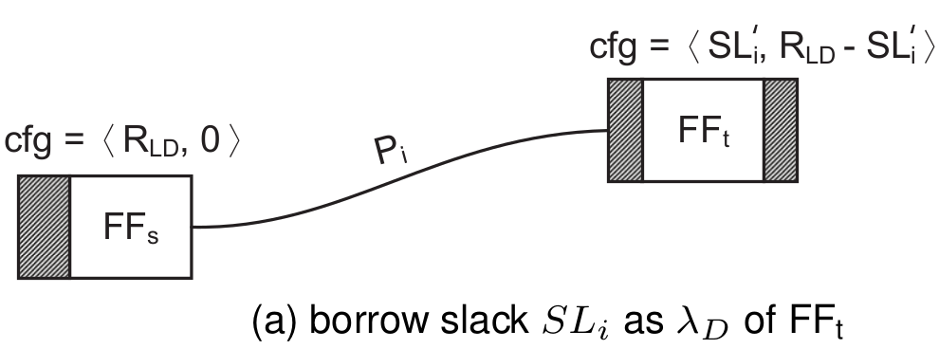
ALDA (4/8)
SL_{i}‘ = slack remaining on path i
r_{i} = regularization term of path i

Slide 19
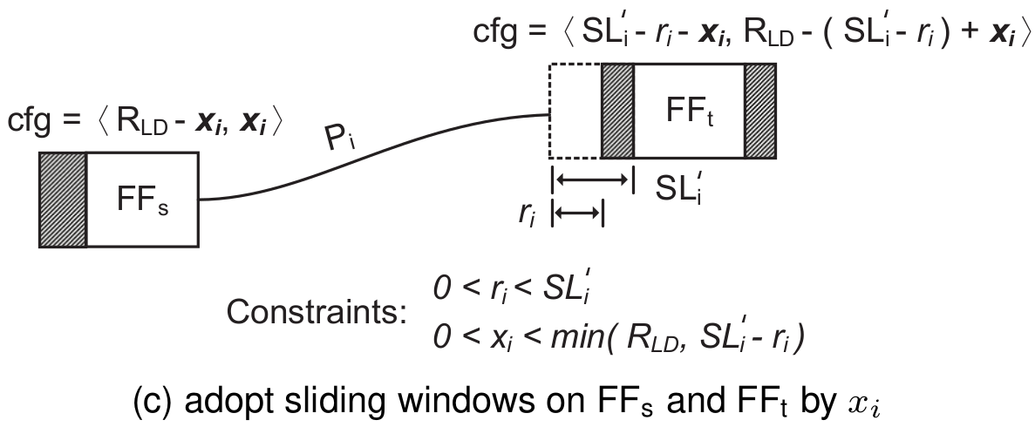
ALDA (5/8)
SL_{i}‘ = slack remaining on path i
r_{i} = regularization term of path i
x_{i} = sliding displacement of path i

Slide 20
ALDA (6/8)
SL_{i}‘ = slack remaining on path I C_{P} = arrival time of critical path
r_{i} = regularization term of path i
x_{i} = sliding displacement of path i

Slide 21
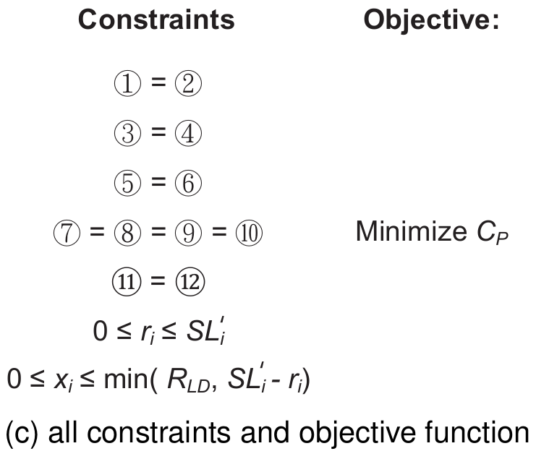
ALDA (7/8)
SL_{i}‘ = slack remaining on path i
r_{i} = regularization term of path i
x_{i} = sliding displacement of path I
C_{P} = arrival time of critical path

Slide 22
ALDA (8/8)

Slide 23
2.
Method
Automated Latching-Delay Assignment (ALDA)
Time Borrowing D-Flip Flop (TBD-FF)

Slide 24
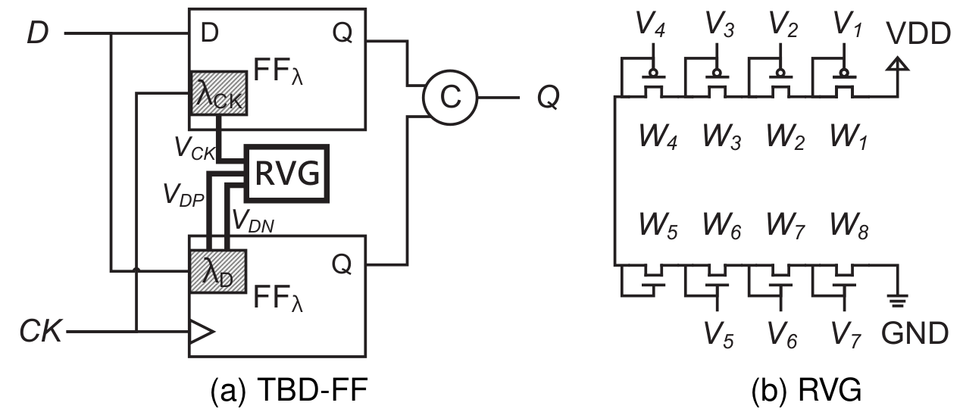
TBD-FF (1/5)

Slide 25
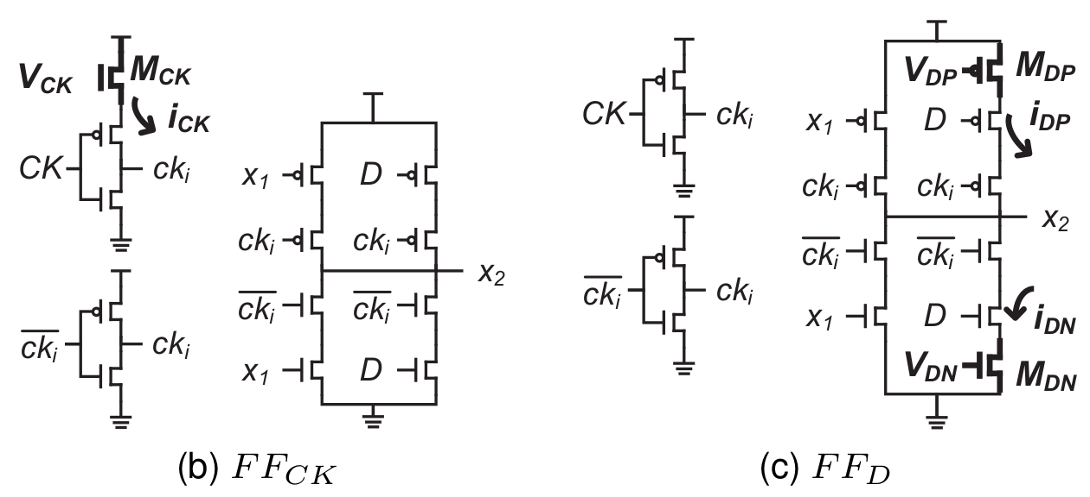
TBD-FF (2/5)

Slide 26
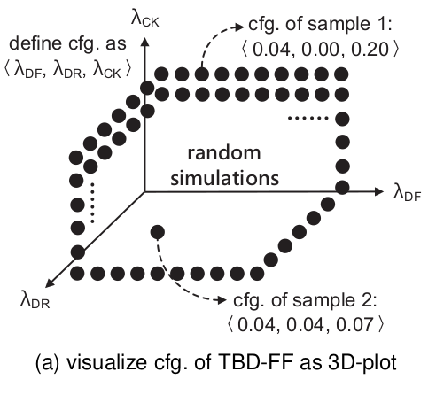
TBD-FF (3/5)

Slide 27
TBD-FF (4/5)

Slide 28
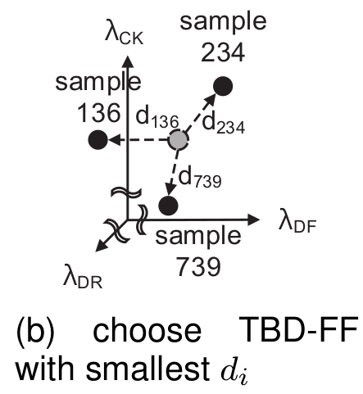
TBD-FF (5/5)

Slide 29
3.
Experiment
Timing performance
Validate latching-delay precision of TBD-FF’s layout

Slide 30
Timing report (1/3)

Slide 31
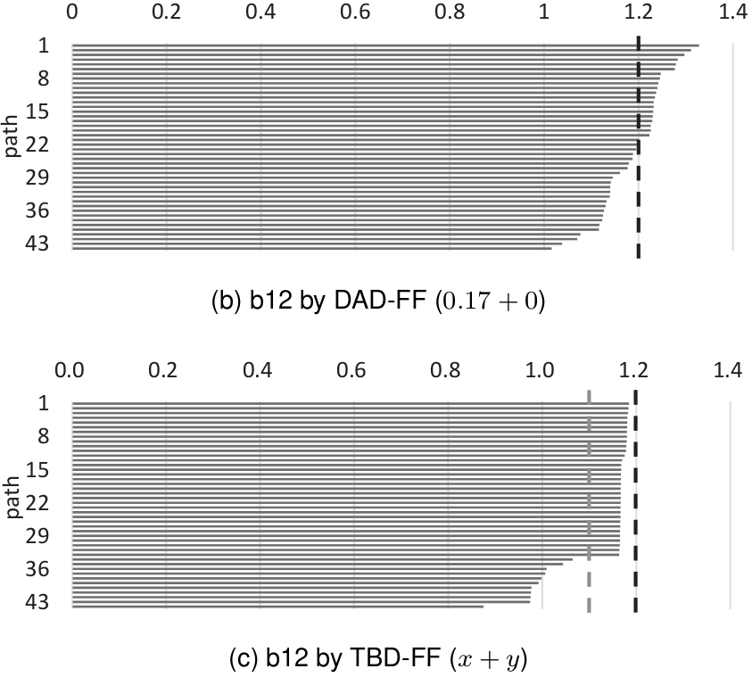
Timing report (2/3)

Slide 32
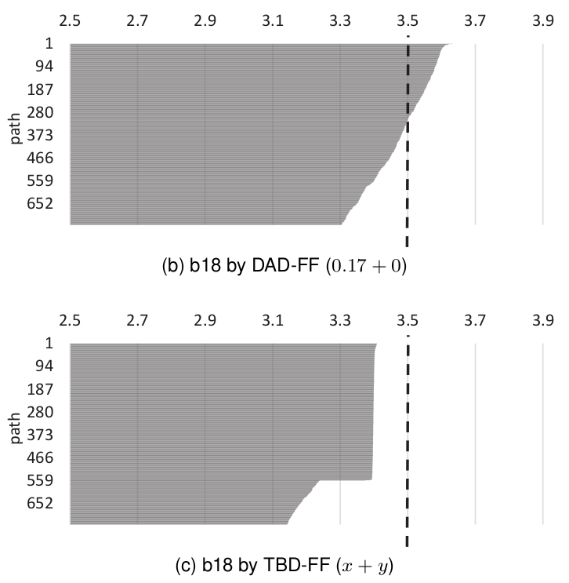
Timing report (3/3)

Slide 33
3.
Experiment
Timing performance
Validate latching-delay precision of TBD-FF’s layout

Slide 34
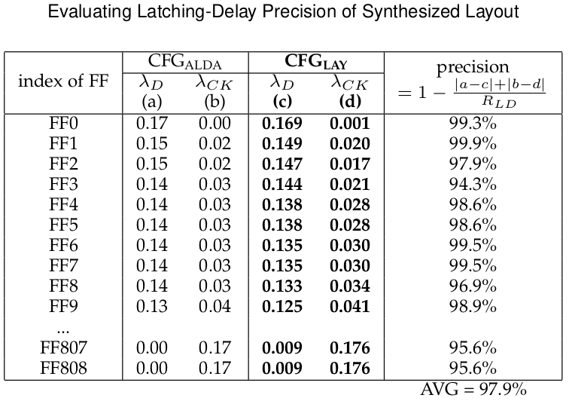
Validate latching-delay precision

Slide 35
4.
Conclusion

Slide 36
Conclusion
Detect the soft error and use time borrowing to reduce the timing overhead due to the delay value.
ALDA: get configuration of all flip-flop
TBD-FF: use λ_{D} and λ_{CK} to slide the window
The timing overhead of Benchmark circuits (>8K) can be reduced to 0% by our method.

Slide 37
Thanks!
Any questions?
You can find me at:
chungli.eed08g@nctu.edu.tw

